Slide 1
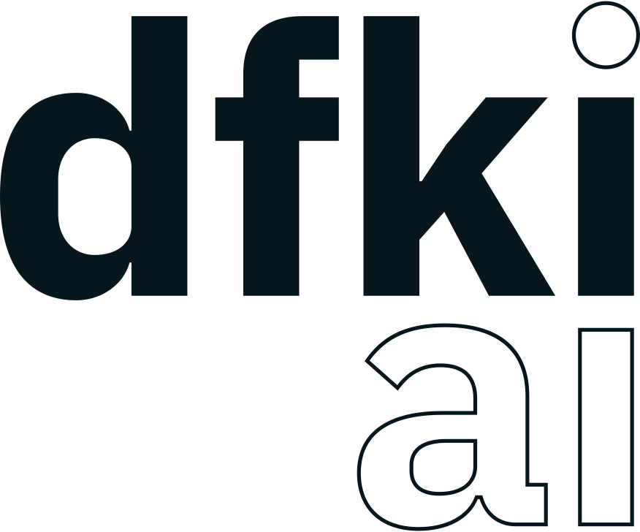
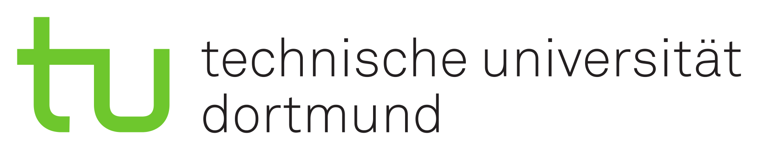
Setting up a ROS2-based Multi-Agent System implementing the Contract Net Protocol and IDS Connectors
Dennis Maecker¹, Henning Gösling^{1,}, Timon Sachweh²
¹ German Research Center for Artificial Intelligence, Osnabrück, Germany
² TU Dortmund University, Germany

Slide 2
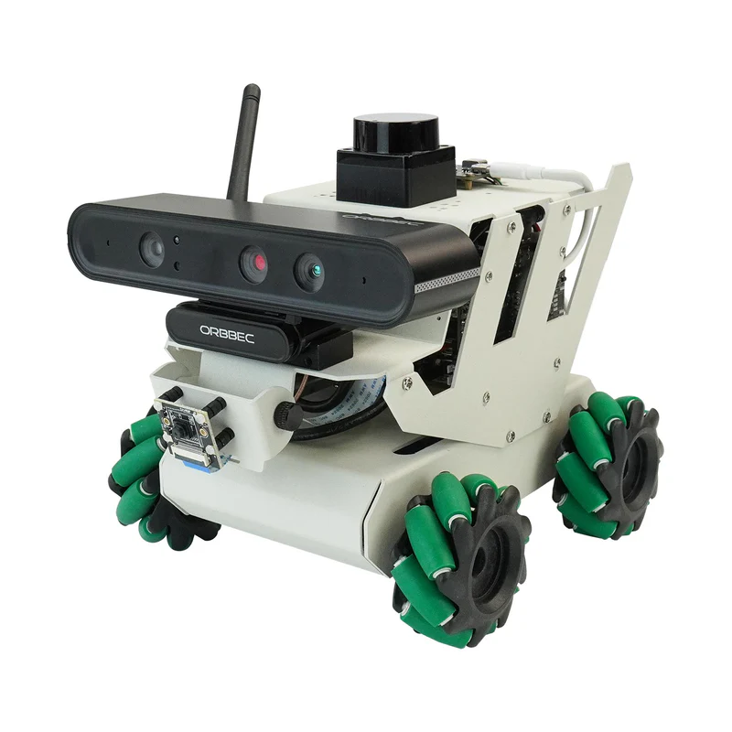
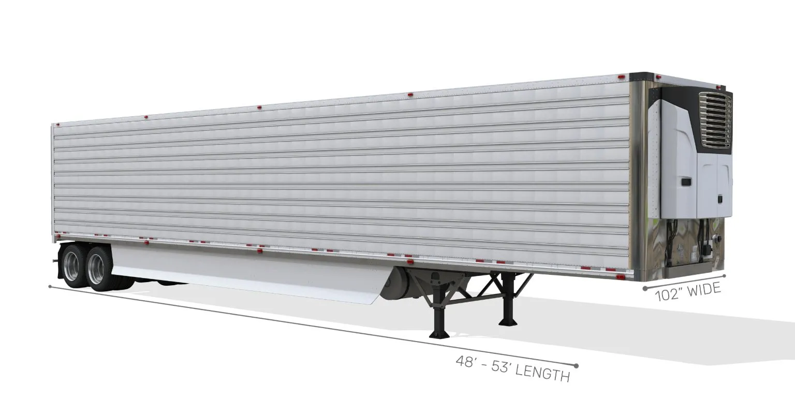
Robot Operating System 2 (ROS2) – Architecture Stack
No vendor lock-ins (built on an abstraction layer with separation between communication and robotic libraries)
Uses open standards
Has a big global community and industry support
Communication is mainly message-based
ROS is well suited, for use cases, where robots or autonomous machines need to be controlled
Interaction with other agents / ROS2 clients can be done with the ROS2 communication protocols

Slide 3
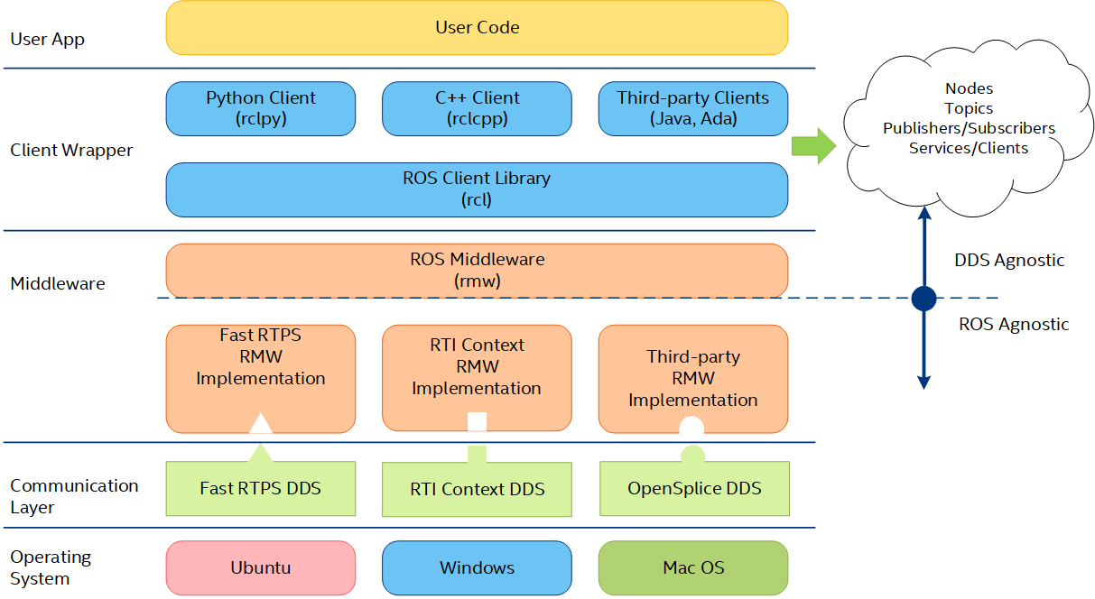
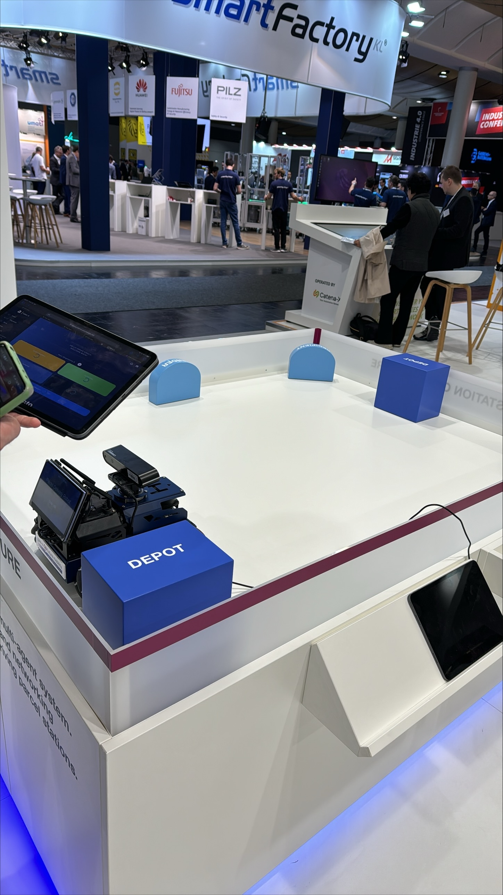
Robot Operating System 2 (ROS2) – Architecture Stack

Slide 4
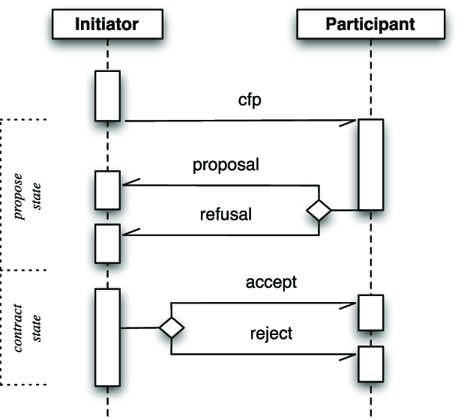
Contract Net Protocol in Multi-Agent Systems
Is a coordination mechanism which acts like auctions
With identifiers, multiple instances of CNP mechanisms can run in parallel
ROS2 uses message-based communication between agents to communicate with each other
We need 4 topics in the ROS2 publish-subscribe message-based communication protocol to build the CNP

Slide 5
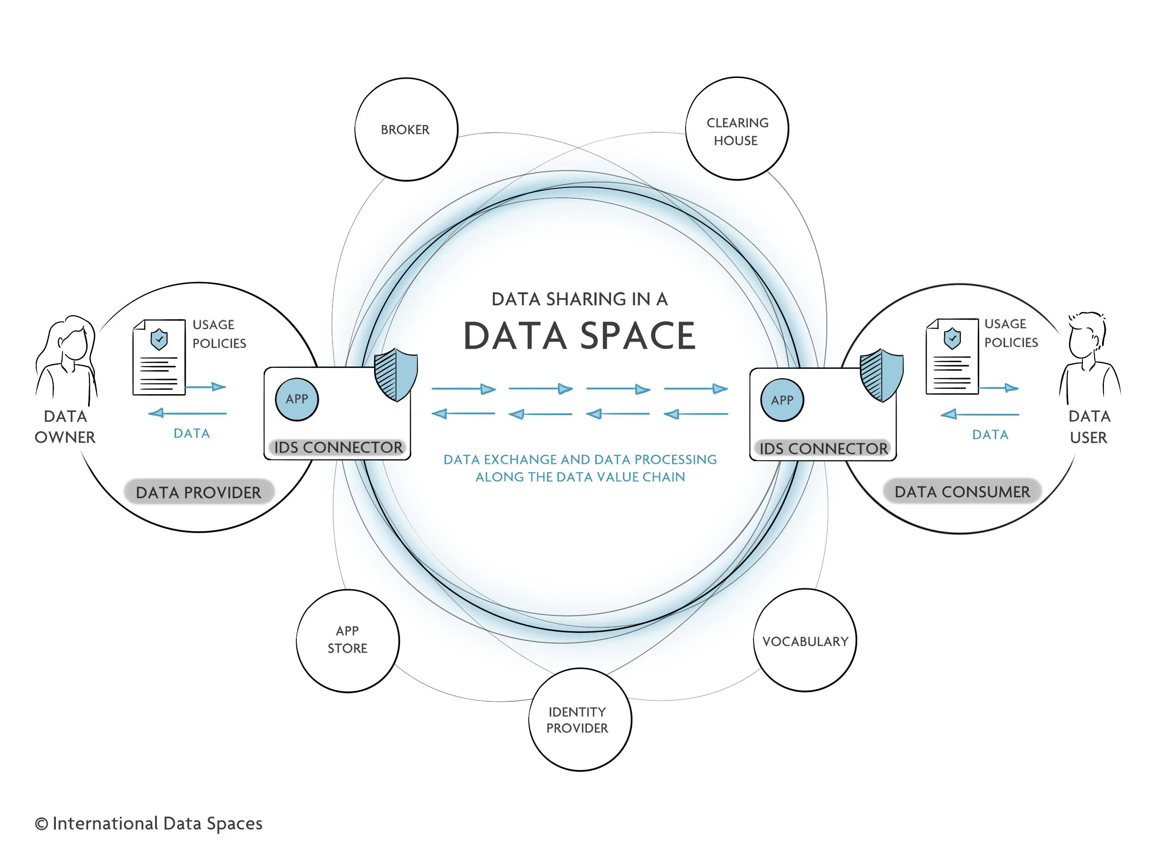
Data Exchange throughout IDS connectors (Federated Data Spaces)

Slide 6
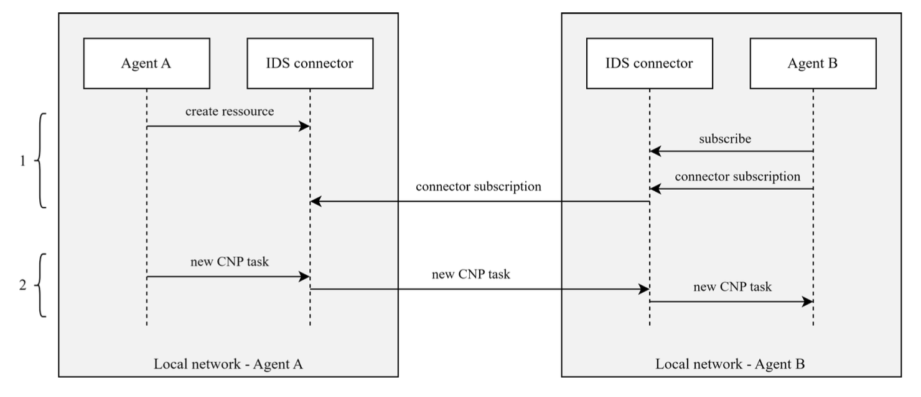
Data Exchange throughout IDS connectors (Federated Data Spaces)

Slide 7
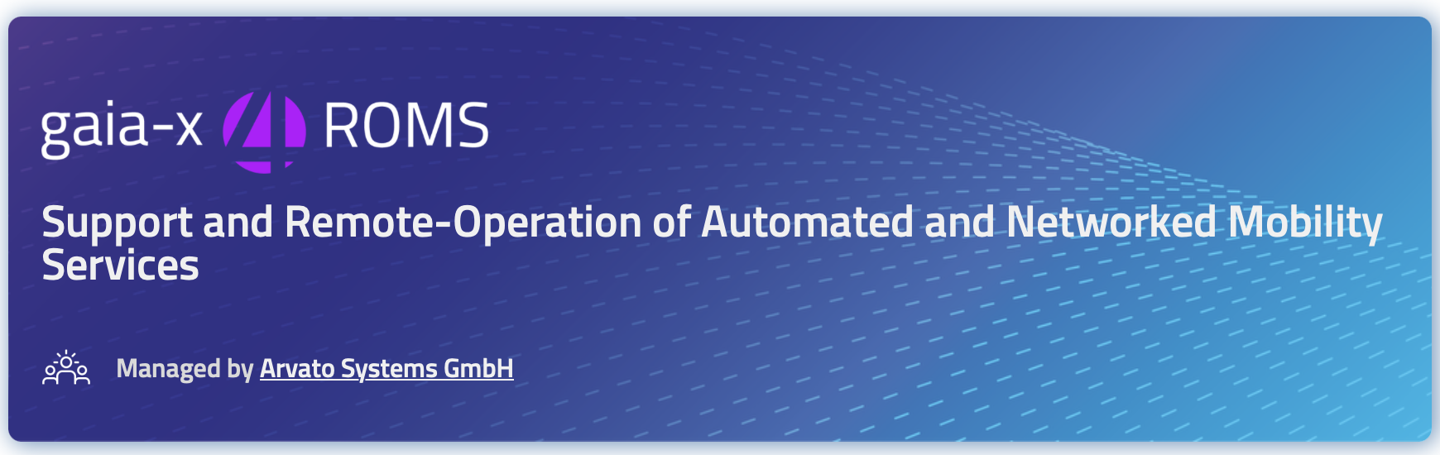
Why those technologies?
We needed to allow agents
to act with a bidding-system to
efficiently calculate freight lists
We needed to be able to run directly on hardware of
logistics companies like trailers or
Autonomous Parcel Delivery Robots

Slide 8
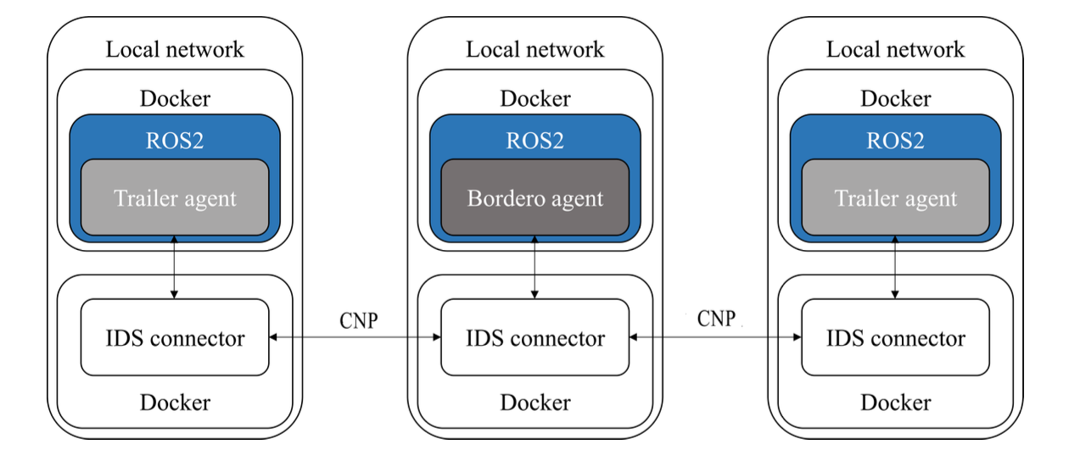
Example Use Case: Transport Logistics Domain
Bordero: Administrates freight lists and provides them to the trailers
Trailer: Is the automated software agent for one trailer in a fleet
Demonstrator for processes between Bordero and Trailer Agents
Tests ran successfully for 100+ software agents
IDS ensures sovereign and secure data exchange

